Slide 1

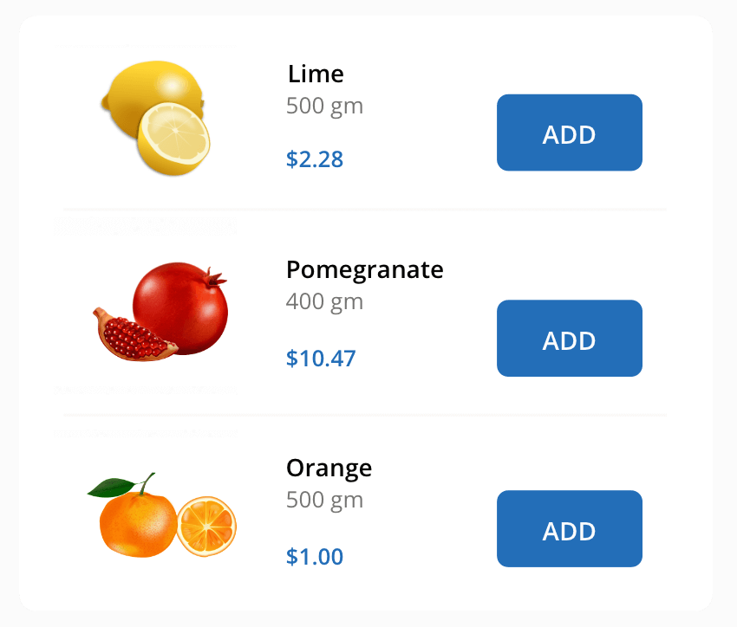
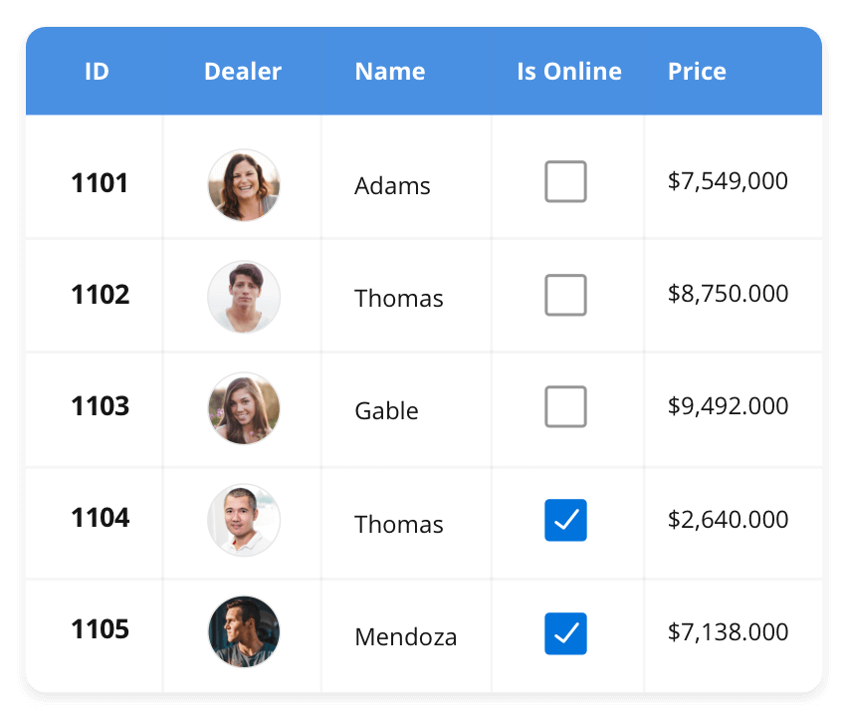
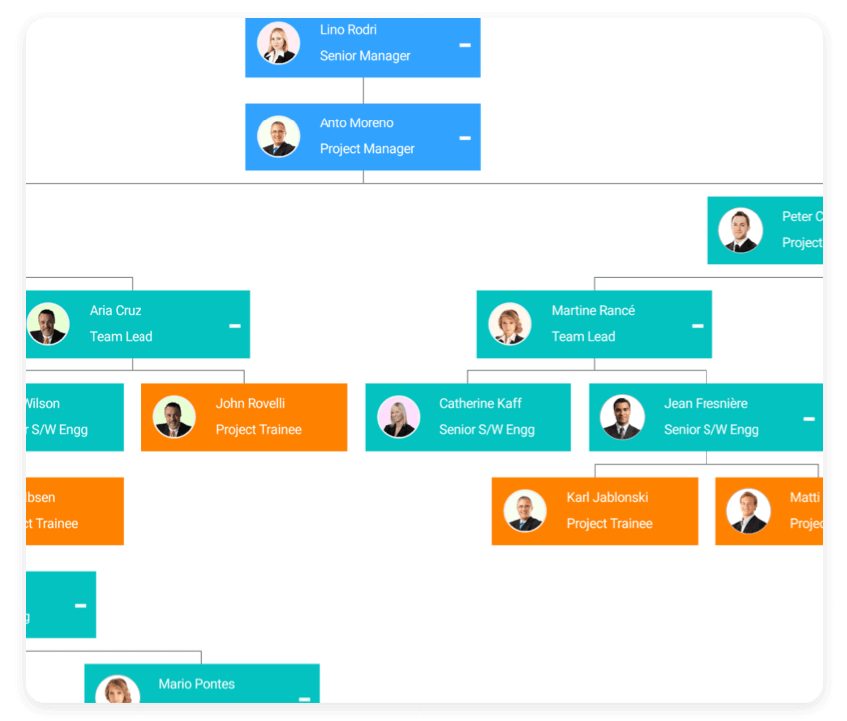
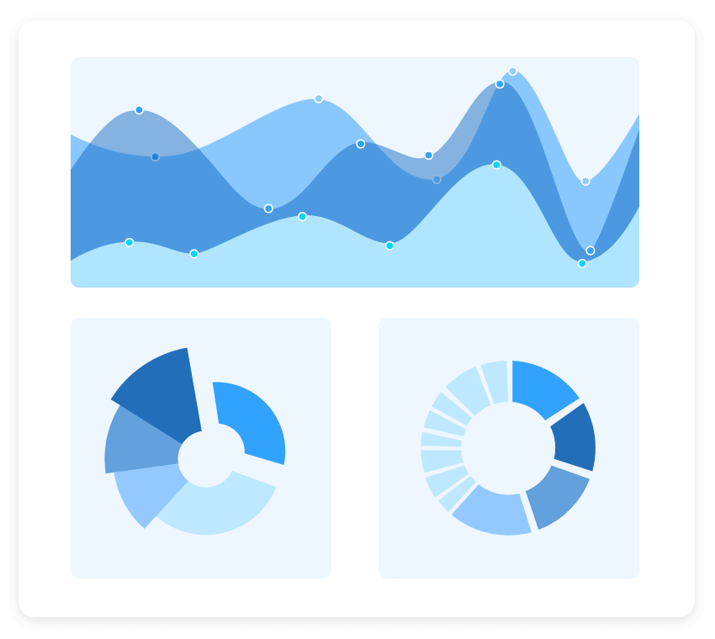
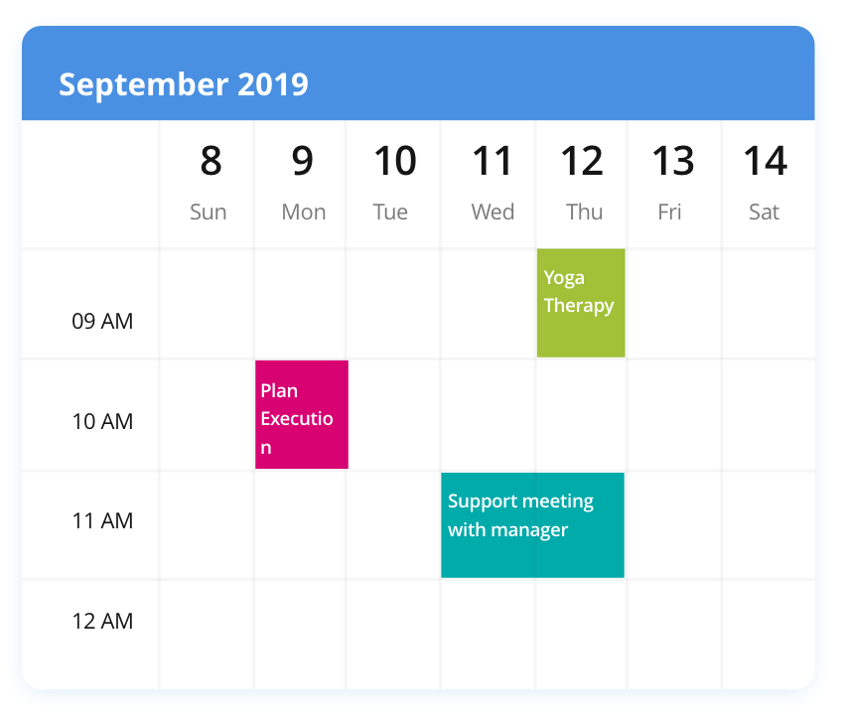
Vasanthakumar SF4654
Software Engineer - Trainee
Date :03-26-24
Most Popular Components
Sync Fusion Pvt.Ltd
Chennai

Slide 2
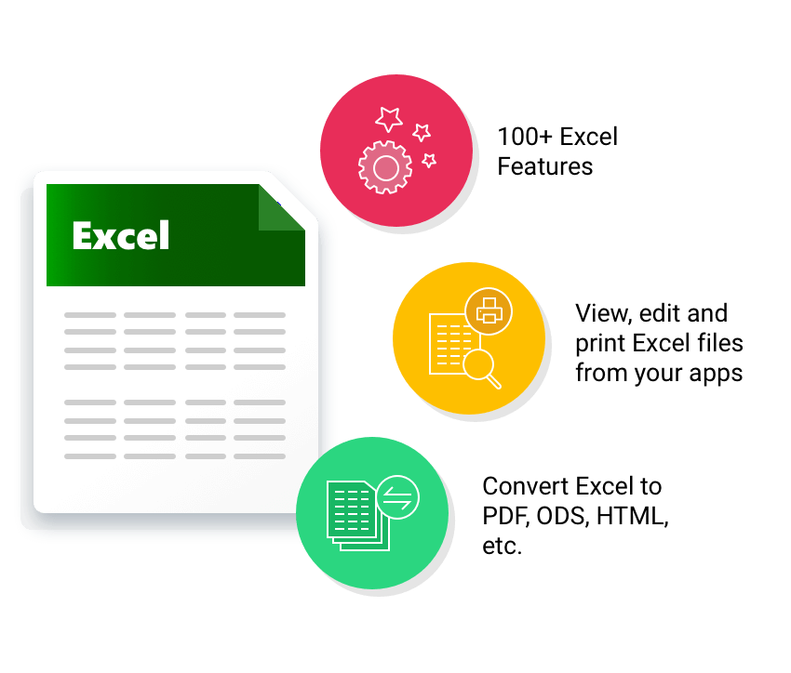
DataGrid
List View
Most popular component
Charts
Scheduler
Diagram
PDF Viewer
Excel Library

Slide 3



Data Grid
Most popular component
The DataGrid control is a high-performance grid component that helps display and manipulate large amounts of data in a tabular format. Its rich feature set includes functionalities like data binding, sorting, grouping, editing, filtering, swiping, dragging, resizing, loading more items, pull-to-refresh, and exporting to Excel and PDF file formats.
JavaScript | Angular | React | Vue
Blazor | Flutter | ASP.NET MVC | ASP.NET Core
WinForms | WPF | WinUI | Flutter
Xamarin | UWP | .NET MAUI
Xamarin | Flutter | UWP | JavaScript | .NET MAUI
3/26/2024
3

Slide 4
Most popular component
Charts
The Charts control can plot a wide range of chart types, ranging from line charts to specialized financial charts. Its rich feature set includes functionalities like data binding, multiple axes, legends, animation, data labels, annotations, trackballs, tooltips, and zooming.
SUPPORTED PLATFORMS
JavaScript | Angular | React | Vue
Blazor | Flutter | ASP.NET MVC | ASP.NET Core
WinForms | WPF | WinUI | Flutter
Xamarin | UWP | .NET MAUI
Xamarin | Flutter | UWP | JavaScript | .NET MAUI

Slide 5
List View
Most popular component
The List View renders a set of data items with UI views or custom templates. It has many features like grouping, sorting, filtering, paging, swiping, multiple selection, drag and drop, and different layout types. The List View control has been optimized to work with large amounts of data.
SUPPORTED PLATFORMS
JavaScript | Angular | React | Vue
Blazor | ASP.NET MVC | ASP.NET Core
WinForms | .NET MAUI | Xamarin
JavaScript | .NET MAUI | Xamarin

